Slide 1
Predicting Accident Severity in Seattle
By - Kapil Warghane

Slide 2
Contents
1 Introduction
2 Data Selection and Cleaning
3 Exploratory Data Analysis
4 Methodology and Data Visualisation
5 Results
6 Conclusion

Slide 3
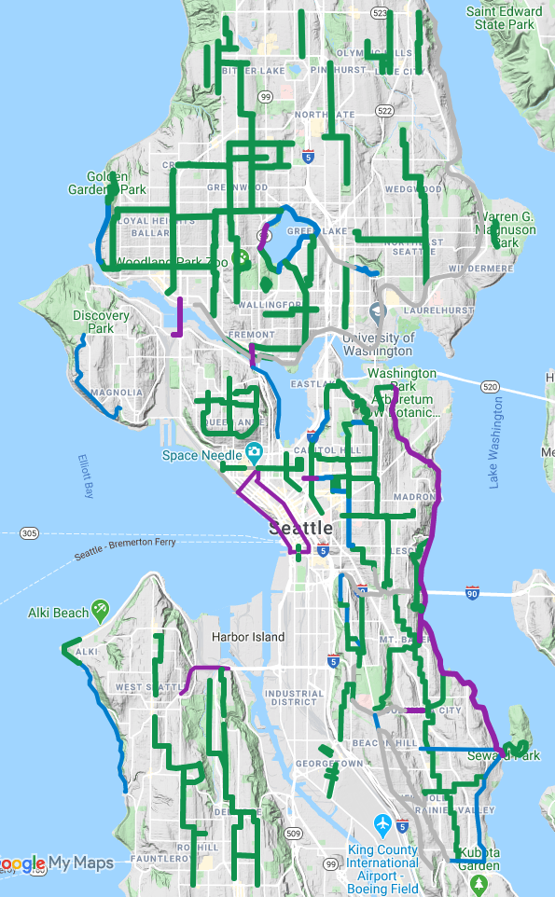
1 Introduction
Seattle metropolitan area's population stands at 3.98 million, making it the 15th-largest in the United States.
Seattle has seen a 30 percent decline in traffic fatalities over the last decade, traffic collisions are still a leading cause of death for Seattle residents age 5-24.
Problem Statement : How we might support Seattle to apply data science to reduce traffic fatalities and injuries across the roads in city?
And make Seattle road trip or journey more accident free.

Slide 4
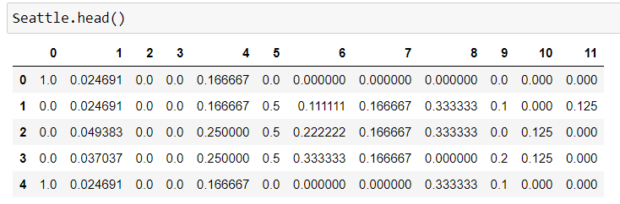
Data Selection and Cleaning
194673 Rows × 38 columns
Dropping Columns with maximum Null Values
Normalizing The values by Max-Min function
Creating Desired Dataset

Slide 5
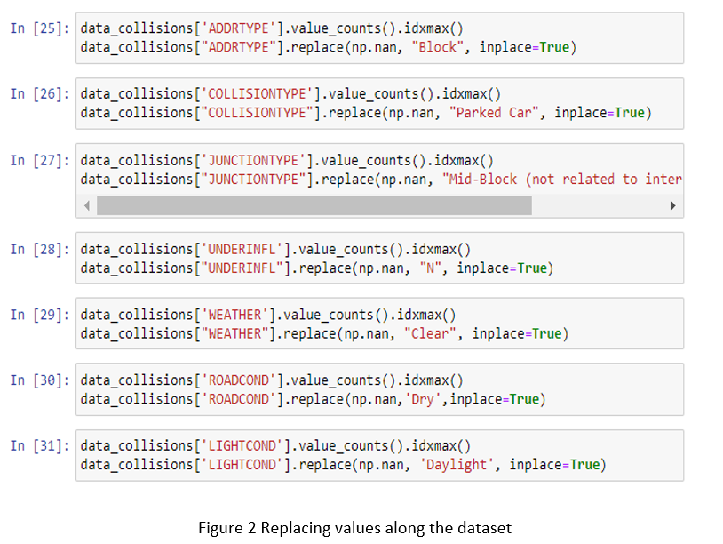
Exploratory Data Analysis
Here we Have replace the null values in data set by taking the most frequent values along the same columns respectively.
Hence, we use. idxmax() function to calculate the maximum number of occurrences of value under a specific column.
To replace the null values we can simply use the replace function of pandas to replace the values along the dataset.

Slide 6
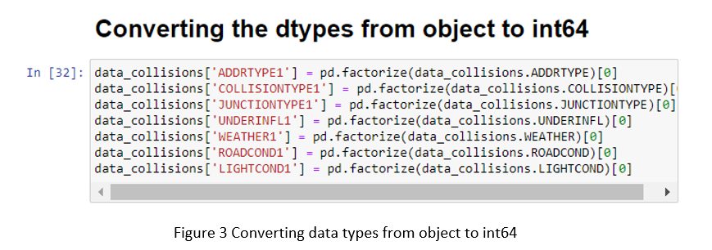
Since our dataset has few columns with categorical values, so we have to change the values to int64.
We have use the factorize function of pandas for converting the data types.

Slide 7
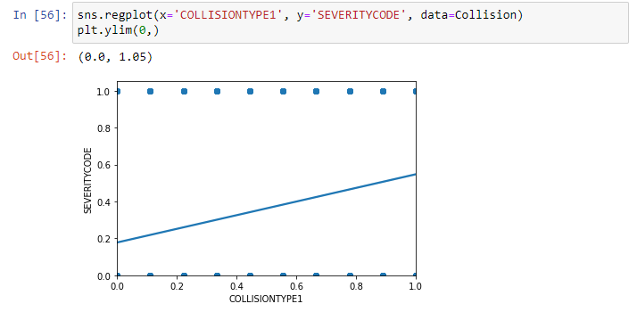
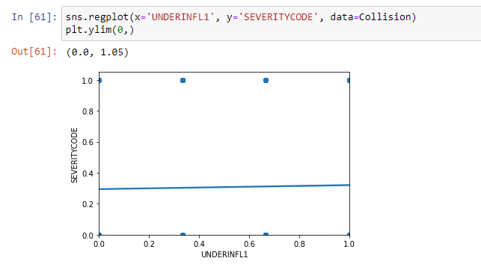
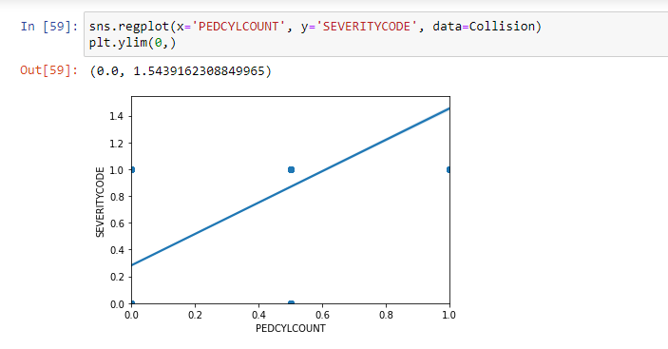
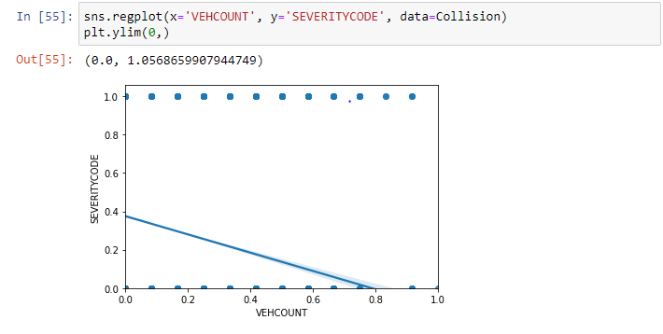
Methodology and Data Visualisation

Slide 8
Results
Since we have more than one independent variable, we can check this problem by using 3 methods
Multiple Linear Regression Model
Polynomial Linear Regression Model
K Nearest Neighbour (KNN) Classification Model
For Multiple Linear Regression we get the RMSE of 0.4179
For Polynomial Linear Regression we get RMSE of 0.4094
For KNN classification model we get Train set Accuracy: 0.7541 and Test set Accuracy: 0.7413
The best accuracy was with 0.7477 with k= 6

Slide 9
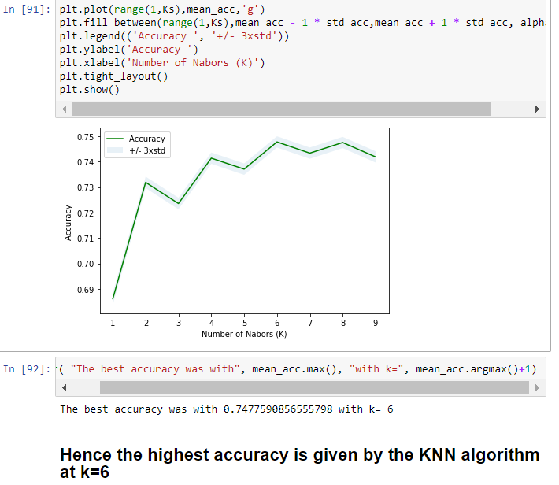
Conclusion
Based on a rule of thumb, it can be said that RMSE values between 0.2 and 0.5 shows that the model can relatively predict the data accurately, hence we can say that our model will give results with a good accuracy.
From the KNN method we can say that our model performs best with k=6 and the accuracy for the Training set is also 74.77 %

